Slide 1
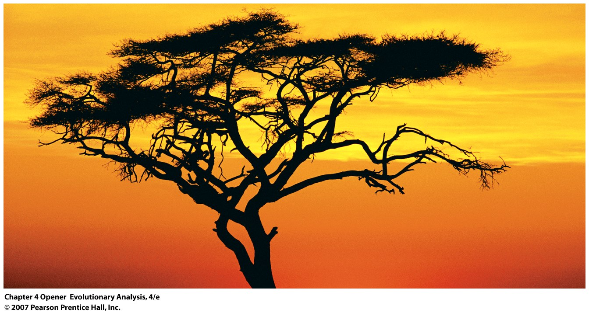
Constructing Phylogenies: Trees and Tree Building
Motivation:
Understand evolutionary relationships, pose evolutionary ??
Notes:
Chapter 4 Opener
This solitary tree is an appropriate symbol for the tree of life—the evolutionary tree that describes the relationships among all species. This chapter introduces the tools that biologists use to analyze the tree of life.

Slide 2
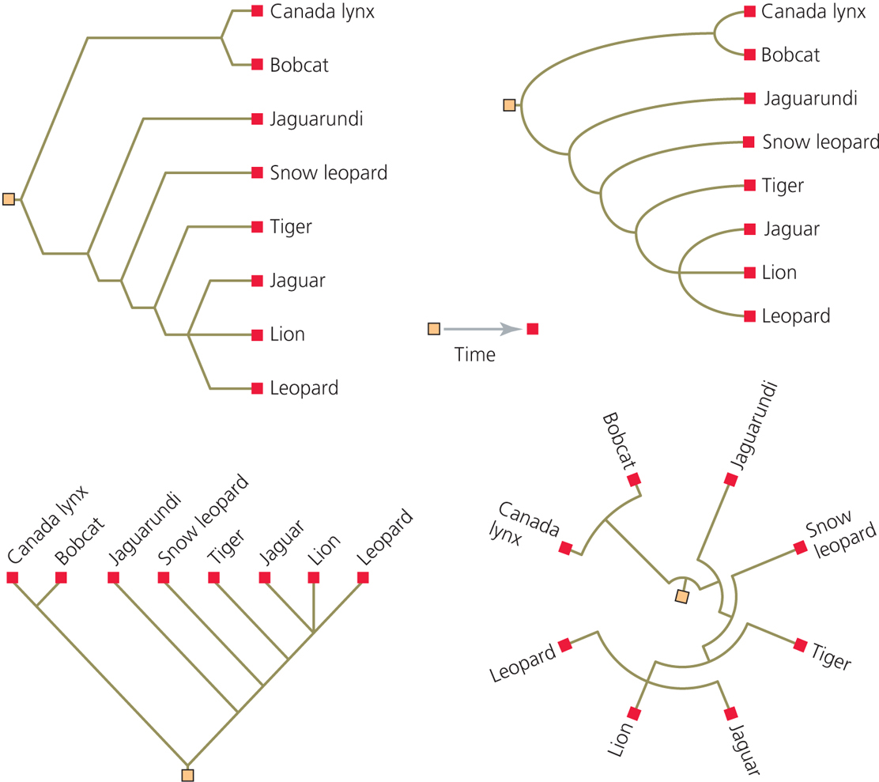

Slide 3
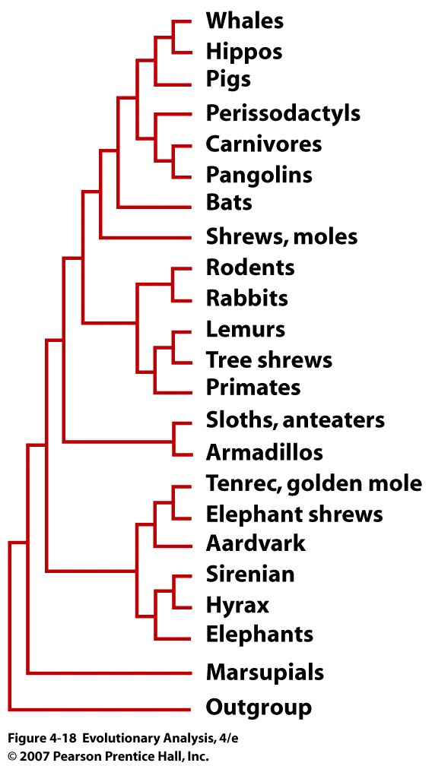
Evolution of Humans
Species related to us
Notes:
Figure 4.18 Phylogeny of the mammals
From Murphy, W.J. et al. (2001).

Slide 4
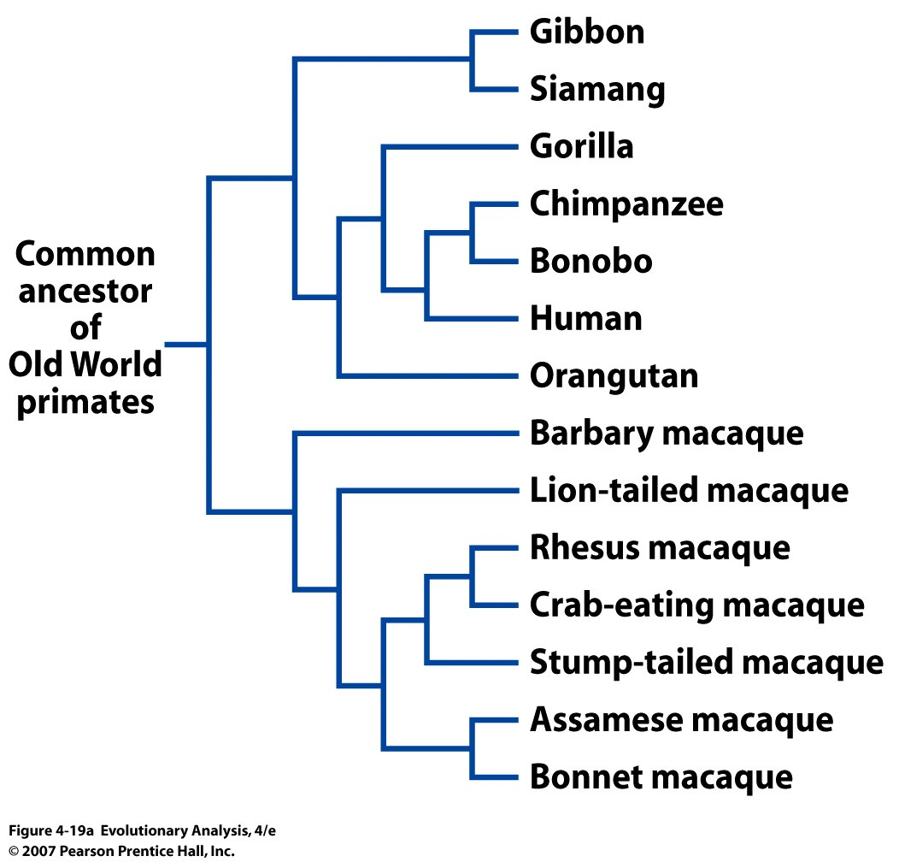
Notes:
Figure 4.19a Phylogenies showing the relationships of some Old World primates
(Branch lengths are not scaled.)

Slide 5
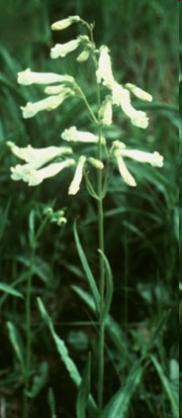
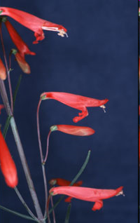
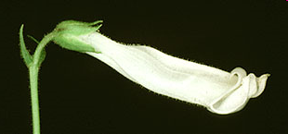
Photos by: Andrea D. Wolfe© and Wayne J. Elisens© (close-up photo)
Location: Campus of University of Oklahoma (Norman, Oklahoma)
II. Methods
Penstemon oklahomensis is a member of Penstemon subg.
Penstemon sect. Penstemon subsect. Penstemon (Bennett et al. 1987).
Its common name is Oklahoma Beardtongue, and it is one of just a
few plants found only in Oklahoma. Penstemon oklahomensis is also
unusual in having a closed throat, which limits nectar access to large
bumblebees..
Penstemon barbatus is a member of
Penstemon subg. Habroanthus sect.
Elmigra. It has a typical hummingbird
floral syndrome. Notice the reflexed
lower lip. Many of the red-flowered
penstemons have a straight corolla
without this reflexed lower lip.
This species can be found in
Arizona, Colorado, New Mexico,
Texas, Utah and Mexico.

Slide 6
Different Approaches: Cladistic vs. Phenetic Methods
Species | Life span | Growth form | Flower size | Flower color | Nectar production
Ancestor | annual | herb | short | white | low
Species 1 | annual | herb | short | white | low
Species 2 | annual | herb | short | white | high
Species 3 | perennial | tree | long | red | high

Slide 7
Phenetic (overall similarity) Cladistic (shared and derived)
Sp 1 2 3 1 2 3
High nectar
Derived state
Ancestor:
Annual, herb, short and white flowers with low nectar production
Synapomorphies:
Traits that are shared and derived and reveal evolutionary branch point

Slide 8
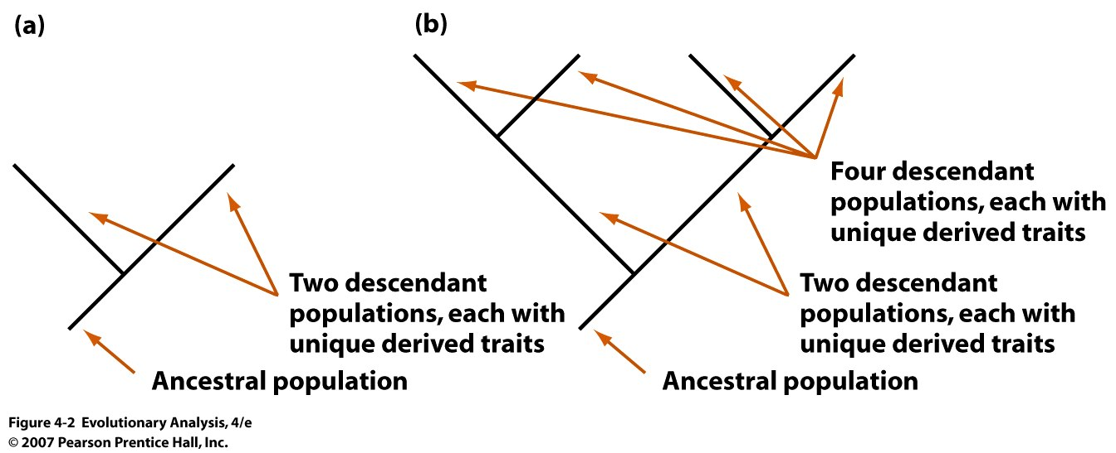
IV. Synapomorphies in Phylogenetic Reconstruction
Synapomorphies arise in shared ancestral populations and are passed
onto descendant populations, thus defining branching points.
Synapomorphies are homologous
As you move up through a tree, from ancestor to descendant clades
there are more and more synapomorphies. Synapomorphies are nested.
Notes:
Figure 4.2 Synapomorphies arise in ancestral populations, and are passed on to descendants
(a) Speciation leads to the creation of two independent populations. Each acquires unique traits by mutation, selection, and genetic drift but they share traits inherited from their common ancestor. (b) As you go up a tree, synapomorphies create a nested hierarchy. Each successive monophyletic group can be identified by synapomorphies that arose in its ancestors.

Slide 9
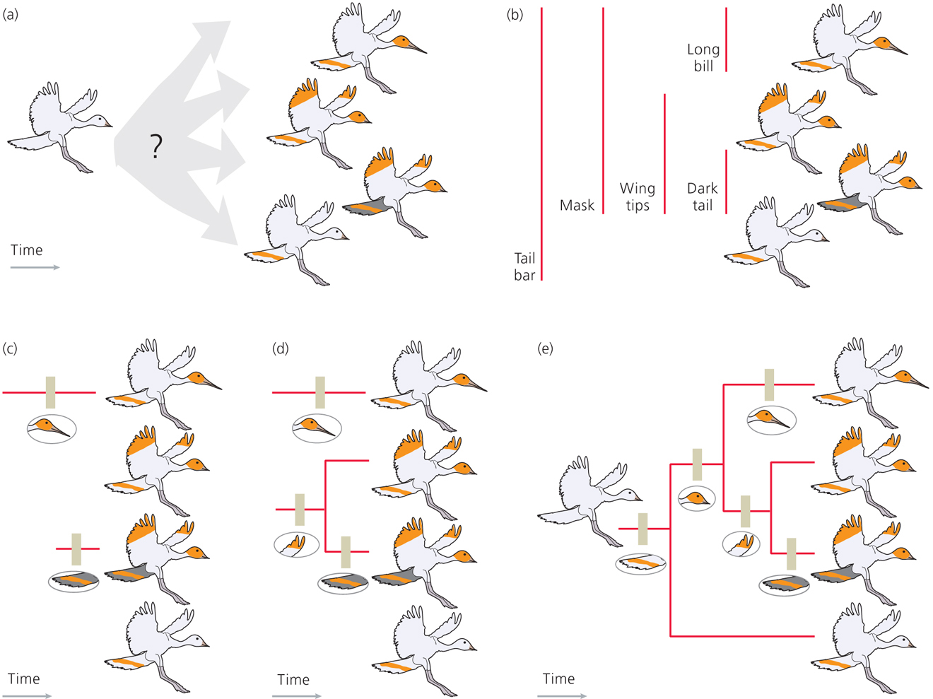
Construct Tree by a series of nested shared and derived events or character state transitions

Slide 10
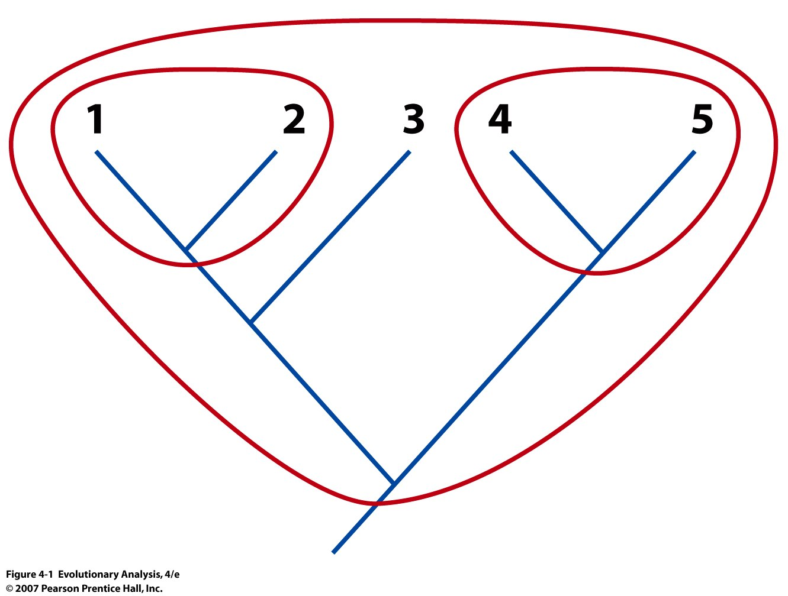
III. Monophyly vs. Paraphyly
Monophyletic groups are comprised of an ancestor & all of its descendants (=clades or lineages)
Notes:
Figure 4.1 Monophyletic groups are comprised of an ancestor and all of its descendants
Monophyletic groups are also called clades or lineages. The groups circled here are all monophyletic. The group described by species 1, 2, 3, and their closest common ancestor is also monophyletic.

Slide 11
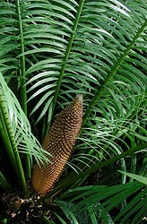
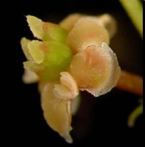

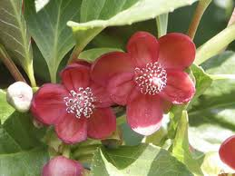
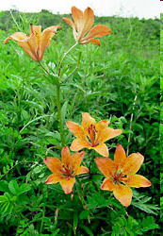
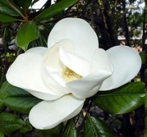
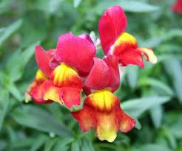
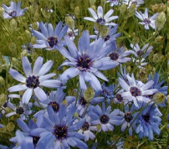
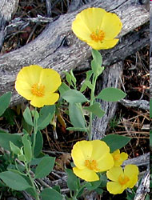
Monophyly vs paraphyly: Angiosperm
Eudicots
Magnoliales
Monocots
Austrobaileyaceae
Nymphaeceae
Amborella
Monophyletic group:
All descendants of a common ancestor
Vs.
Some but not all descendants
Outgroup
Gymnosperms
Notes:
Draw how would look if dicots were monophyletic
Figure 4.13 Monophyletic and paraphyletic groups
Paraphyletic group- a group that has a common ancestor but that does not include all of the descendants of the common ancestor.
Birth death

Slide 12
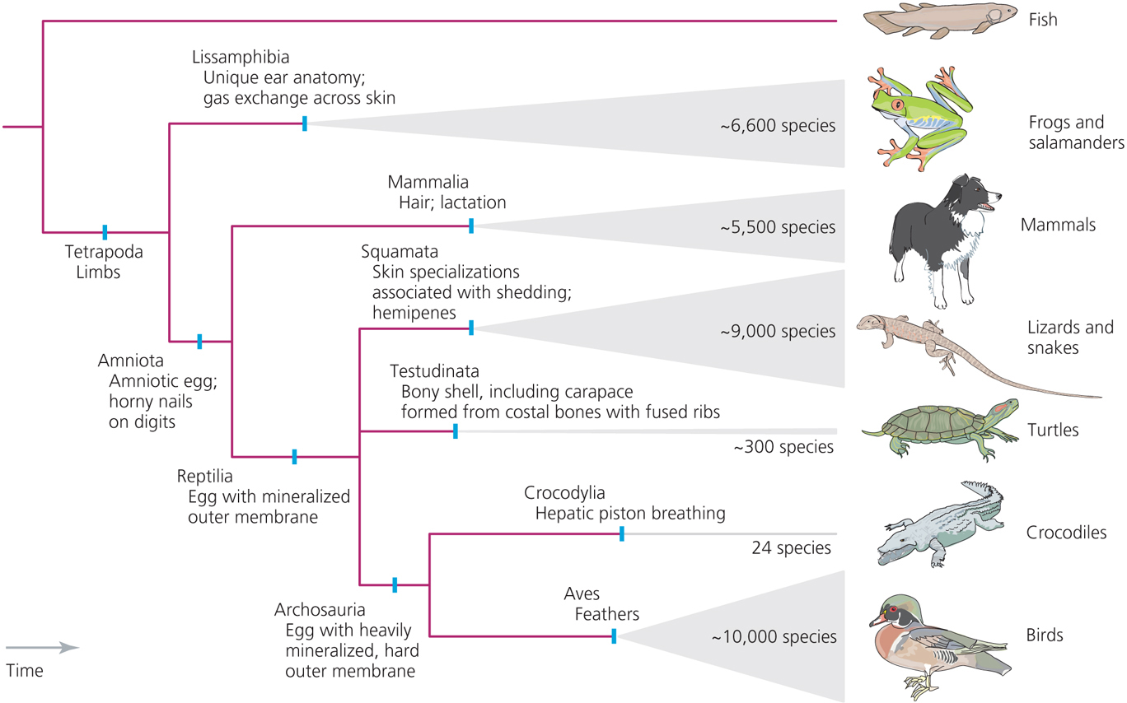
Major Monophyletic groups of tetrapods
Synapomorphies reveal the relationships among tetrapods
Trees built from synapomorphies = cladograms

Slide 13
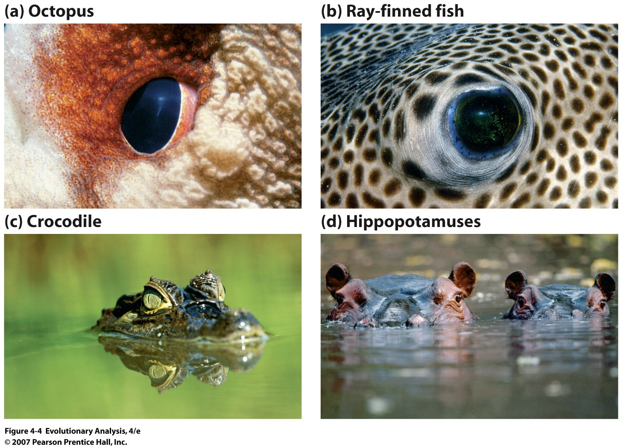
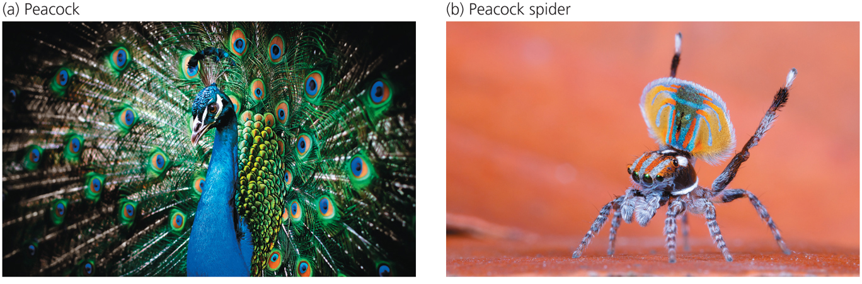
V. The Right Traits
The importance of recognizing and using homologous traits
versus shared traits reflecting homoplasy
Homology: A trait that is similar between two species because of
inheritance of that trait from a common ancestor
Homoplasy: A trait that is similar between two species because of
convergent evolution, parallelism or reversal, but not
because of shared ancestry
Notes:
Figure 4.4 Similar traits may not be homologous
The pairs of species shown have similar traits even though they are not closely related. The octopus (a) and ray-finned fish (b) have camera eyes. The crocodile (c) and hippos (d) have skulls in which the eyes sit on top. These similarities are due to convergent evolution, not common ancestry.

Slide 14
Homoplasy:
A trait that is similar between two species because of convergent evolution, parallelism or reversal, but not because of shared ancestry
Convergent evolution:
Similarity between species that is caused by a similar but evolutionarily independent response to similar selection pressures (great evidence for an adaptation). Ancestors are different in appearance, but the two descendants now look alike for that trait.
Parallelism:
The independent acquisition in 2 or more related descendant species of similar derived character (great evidence for an adaptation, often same genes, but different alleles). Ancestors look similar and so do the descendants.
Reversal: return to an ancestral condition
Notes:
Convergent Evolution: for example you would not say that whales have regained fins, or marine habit, because their closest ancestors are land dwelling animals and not fish
Parallelism:
For example, some might call the modification of the vertebrate limb to become a wing in bats and birds to be an example of parallel evolution. Vertebrate forelimbs have a common origin and thus, in general, show divergent evolution. However, the modification to the specific structure and function of a wing evolved independently and in parallel within several different vertebrate clades.

Slide 15
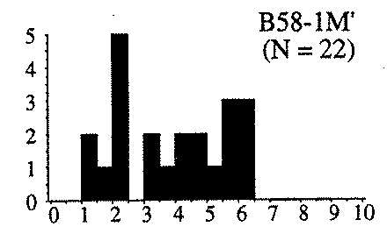
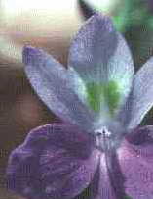
Parallel Evolution of Mating System
Brazil South
Eichhornia paniculata
Brazil North
South x North
Fenster and Barrett 1995
Length of Filament

Slide 16
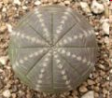
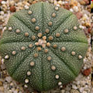
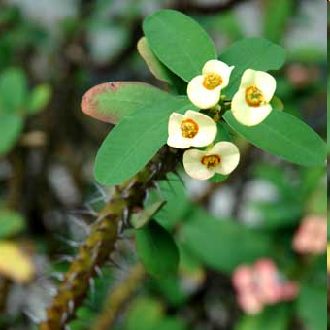
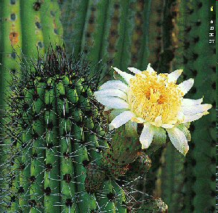
Convergent evolution of succulence: Euphorbiaceae left, Cactaceae right
The trait succulence is a homoplasy arising from convergent evolution

Slide 17
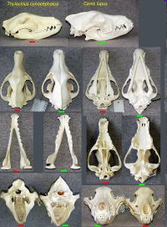
Convergent evolution
within mammals
Marsupial
Tasmanian wolf
Grey Wolf
The skulls of the Thylacine (left) and the Grey Wolf, Canis lupus,
are almost identical, although the species are only very distantly
related (different infraclasses). The skull shape of the Red Fox,
Vulpes vulpes, is even closer to that of the Thylacine.
Notes:
Thylacine
From Wikipedia, the free encyclopedia
Jump to: navigation, search
Thylacine[1]
Fossil range: Early Pliocene to Holocene
Thylacines in Washington D.C., 1902Conservation status
Extinct (1936) (IUCN 3.1)[2]Scientific classificationKingdom:Animalia
Phylum:Chordata
Subphylum:Vertebrata
Superclass:Tetrapoda
Class:Mammalia
Subclass:Theria
Infraclass:Marsupialia
Order:Dasyuromorphia
Family:†Thylacinidae
Genus:†Thylacinus
Species:†T. cynocephalus
Binomial nameThylacinus cynocephalus
(Harris, 1808)
The Thylacine (pronounced /ˈθaɪləsaɪn/,[3] or in Australia /ˈθaɪləsiːn/,[4] also /ˈθaɪləsɨn/[5]) (binomial name: Thylacinus cynocephalus; Greek for "dog-headed pouched one") was the largest known carnivorous marsupial of modern times. It is commonly known as the Tasmanian Tiger (because of its striped back), the Tasmanian Wolf, and colloquially the Tassie (or Tazzy) Tiger or simply the Tiger.[6] Native to continental Australia, Tasmania and New Guinea, it is thought to have become extinct in the 20th century. It was the last extant member of its genus, Thylacinus, although several related species have been found in the fossil record dating back to the early Miocene.
The Thylacine had largely become extremely rare or extinct on the Australian mainland before European settlement of the continent, but it survived on the island state of Tasmania along with several other endemic species, including the Tasmanian Devil. Intensive hunting encouraged by bounties is generally blamed for its extinction, but other contributory factors may have been disease, the introduction of dogs, and human encroachment into its habitat. Despite its official classification as extinct, sightings are still reported, though none proven.
Like the tigers and wolves of the Northern Hemisphere, from which it obtained two of its common names, the Thylacine was an apex predator. As a marsupial, it was not related to these placental mammals, but because of convergent evolution it displayed the same general form and adaptations. Its closest living relative is thought to be either the Tasmanian Devil or Numbat.
The Thylacine was one of only two marsupials to have a pouch in both sexes (the other being the Water Opossum). The male Thylacine had a pouch that acted as a protective sheath, protecting the male's external reproductive organs while running through thick brush.
Placental mammals and marsupials diverged about 125 mya

Slide 18
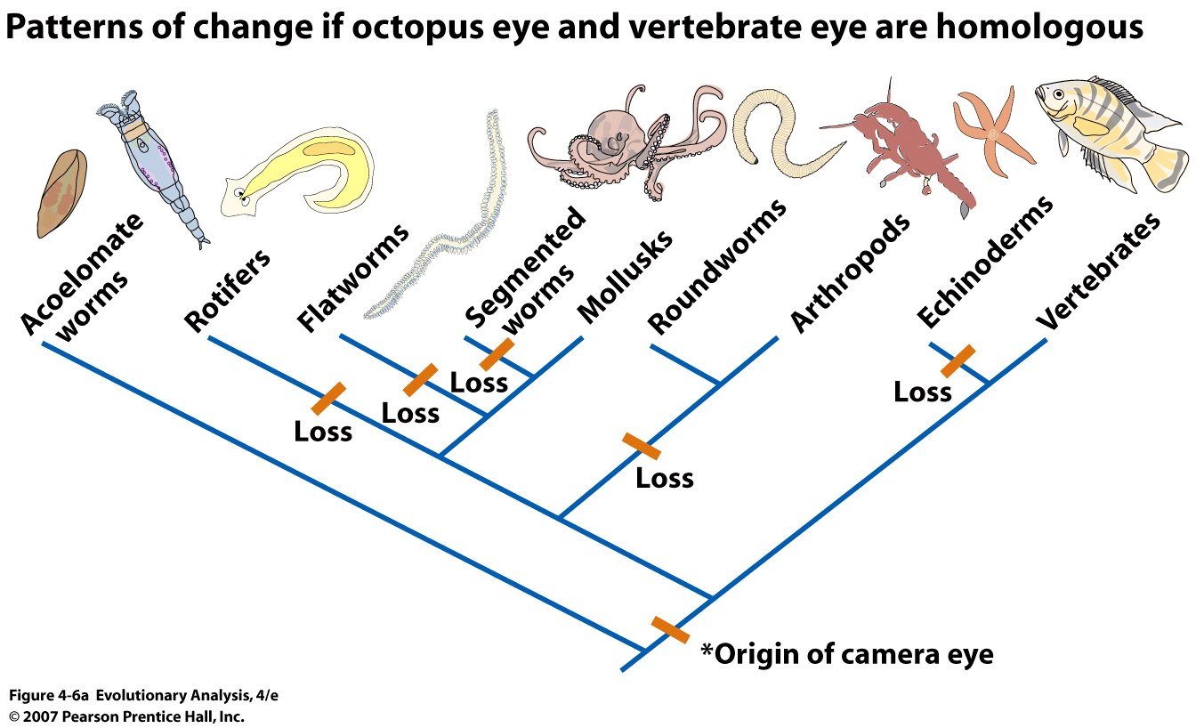
VI. Parsimony: least number of steps to construct a phylogeny
Using parsimony to distinguish homology from homoplasy
(Tree made from DNA synapomorphies) (also development)
Notes:
Figure 4.6a Using parsimony to distinguish homology from homoplasy
The trees shown were estimated using a large number of synapomorphies in DNA sequences. (a) If the camera eyes of octopuses and vertebrates are homologous, then six evolutionary changes occurred, as shown.

Slide 19
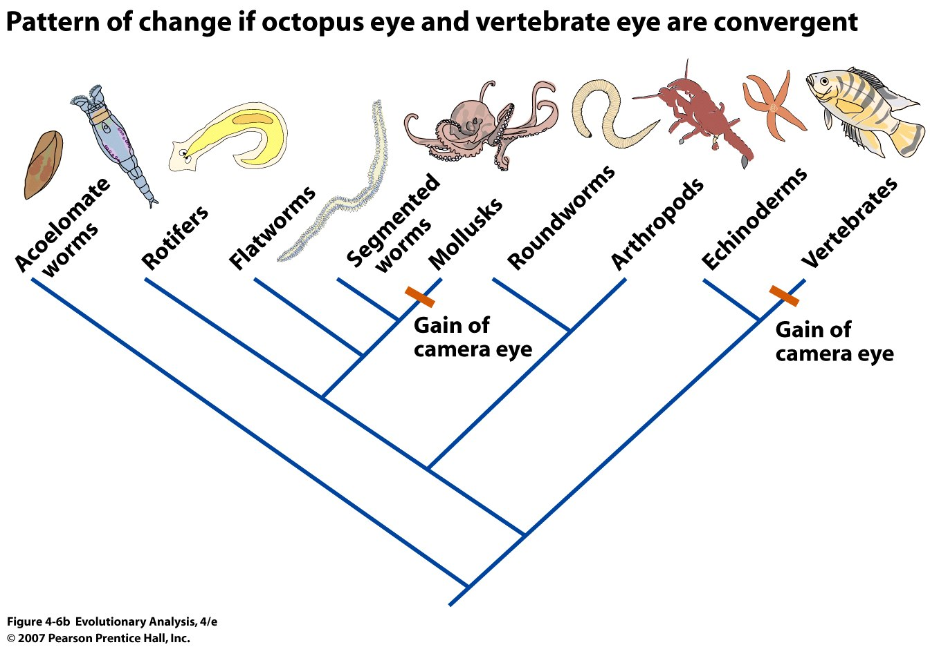
Notes:
Figure 4.6b Using parsimony to distinguish homology from homoplasy
The trees shown were estimated using a large number of synapomorphies in DNA sequences. (b) If the camera eyes of octopuses and vertebrates are convergent, then two evolutionary changes occurred, as shown.

Slide 20
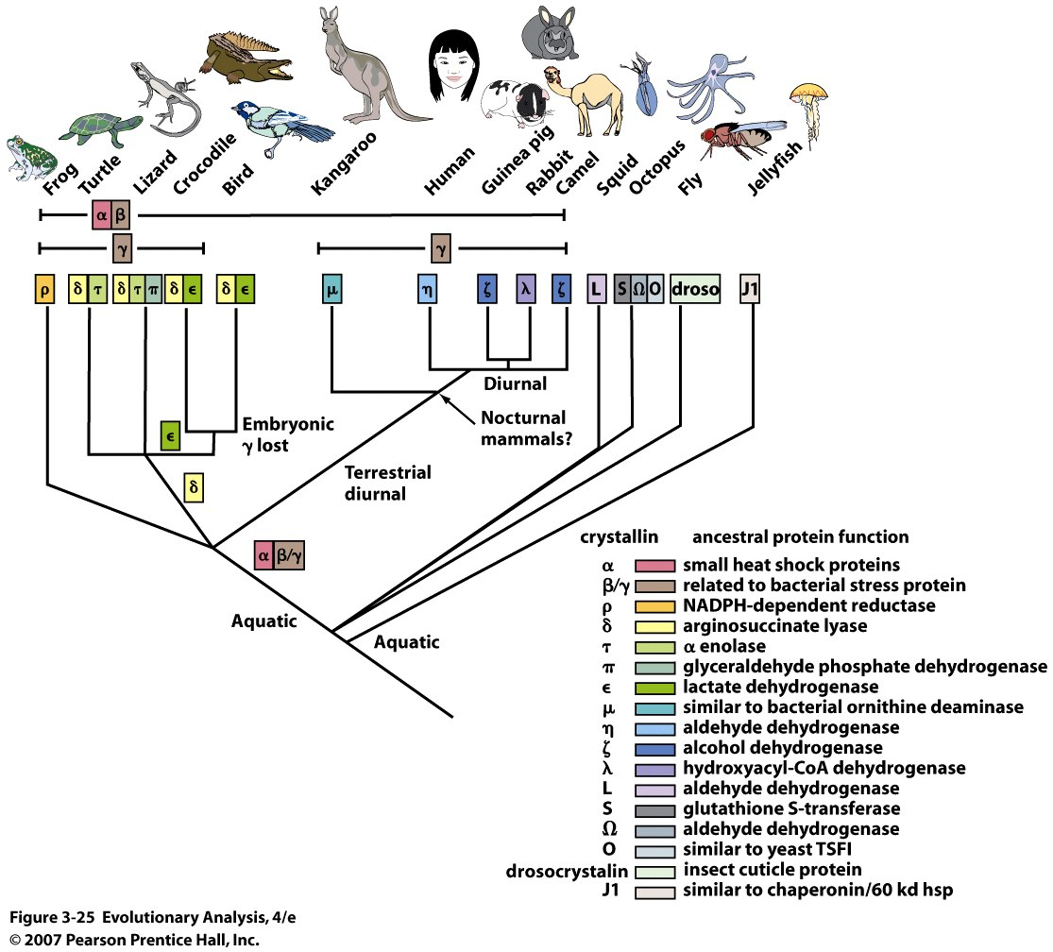
Gene co-option in the crystallins (H₂O soluble proteins)
of animal eye lenses

Slide 21
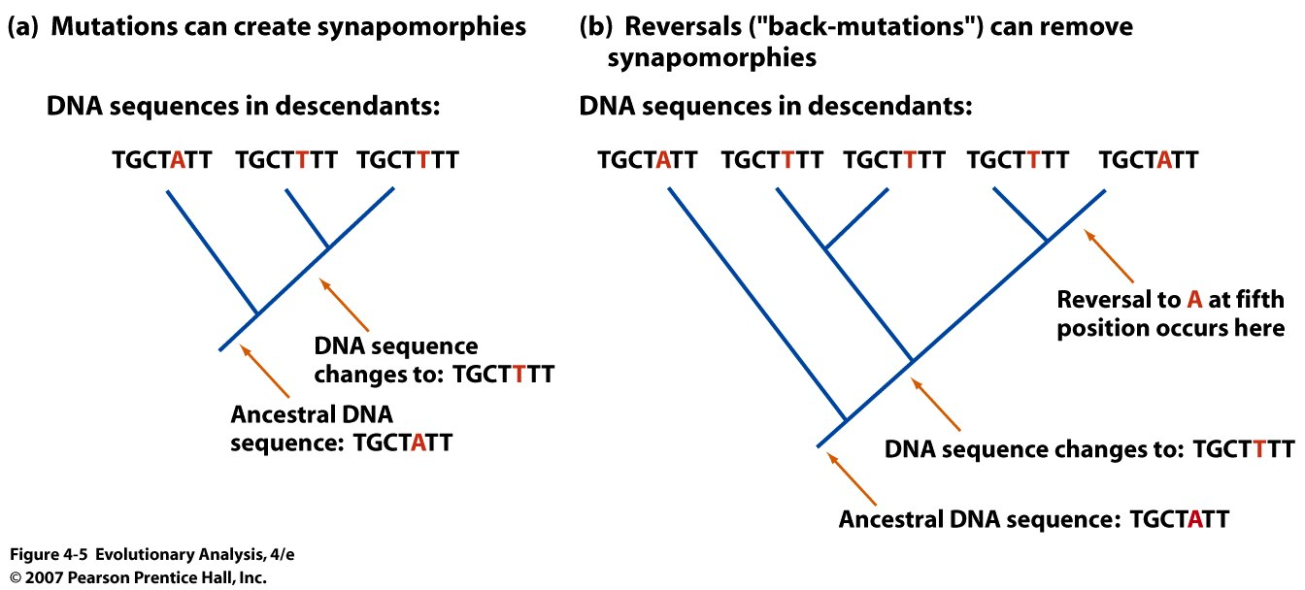
Use Parsimony to create tree
Notes:
Figure 4.5 Reversals complicate phylogeny inference
(a) Read this tree up from the root, and notice that a change in the fifth position of this DNA sequence creates a shared, derived character in the descendant populations. (b) If a reversal changed the fifth position back to the ancestral state later in the evolution of this group, it would make it much more difficult to infer the correct phylogeny.

Slide 22
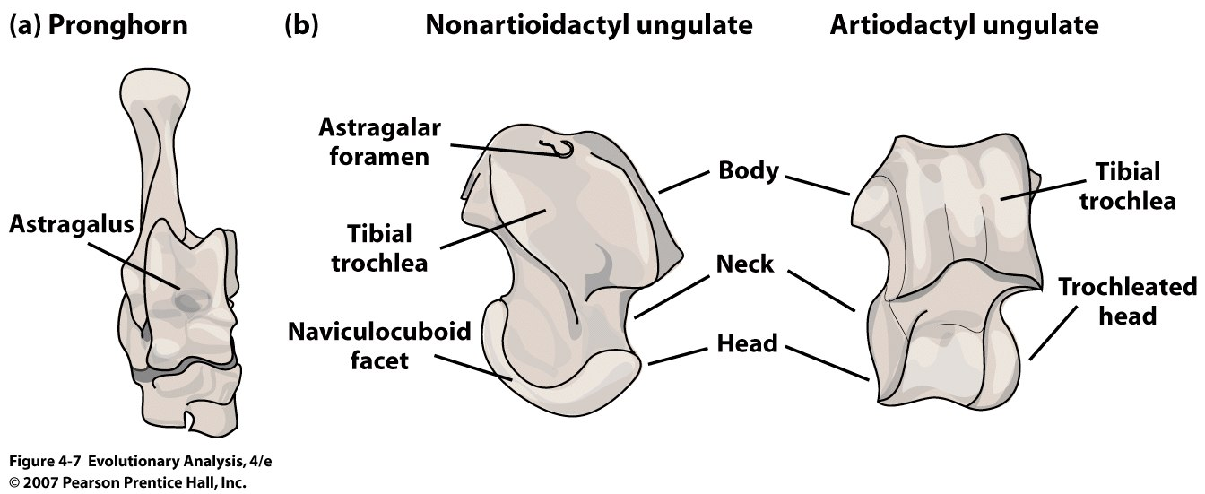
VII. Systematic relationships of the whale
Odd toed (horses) Even toed (deer)
artiodactyl
The astragalus is a syanpomorphy that defines artiodactyls
Notes:
Evolution
The talus is apparently derived from the fusion of three separate bones in the feet of primitive amphibians; the tibiale, articulating with tibia, the intermedium, between the bases of the tibia and fibula, and the fourth centrale, lying in the mid-part of the tarsus. These bones are still partially separate in modern amphibians, which therefore do not have a true talus. The talus forms a considerably more flexible joint in mammals than it does in reptiles. This reaches its greatest extent in artiodactyls, where the distal surface of the bone has a smooth keel to allow greater freedom of movement of the foot, and thus increase running speed.^{[4]}
Whales share many skeletal features with ungulates, are they in the Artiodactyl clade?, Hippos spend a lot of time in water, are they an outgroup or withing the Artiodactyl
Figure 4.7 The astragalus is a synapomorphy that defines artiodactyls
The astragalus is the highest bone in the ankle, around which the foot rotates to extend forward or backward. (b) The astragalus of a nonartiodactyl ungulate (left) and an artiodactyl ungulate (right). In the artiodactyl, both ends of the astragalus are pulley-shaped. From Schaeffer (1948). Copyright © 1948 Evolution. Reprinted by permission of Evolutio
The even-toed ungulates form the mammal order Artiodactyla. They are ungulates whose weight is borne (if they have more than two toes) about equally by the third and fourth toes, rather than mostly or entirely by the third as in perissodactyls. Another key distinguishing feature is the shape of the astragalus (a bone in the hock joint), which has a double-pulley structure in artiodactyls, giving the foot greater flexibility.[1] n. By the Late Eocene (46 million years ago), the three modern suborders had already developed: Suina (the pig group); Tylopoda (the camel group); and Ruminantia (the goat and cattle group). Nevertheless, artiodactyls were far from dominant at that time: the odd-toed ungulates (ancestors of today's horses and rhinos) were much more successful and far more numerous. Even-toed ungulates survived in niche roles, usually occupying marginal habitats, and it is presumably at that time that they developed their complex digestive systems, which allowed them to survive on lower-grade food.
The appearance of grasses during the Eocene and their subsequent spread during the Miocene (about 20 million years ago) saw a major change: grasses are very difficult to eat and the even-toed ungulates with their highly-developed stomachs were better able to adapt to this coarse, low-nutrition diet, and soon replaced the odd-toed ungulates as the dominant terrestrial herbivores. No

Slide 23
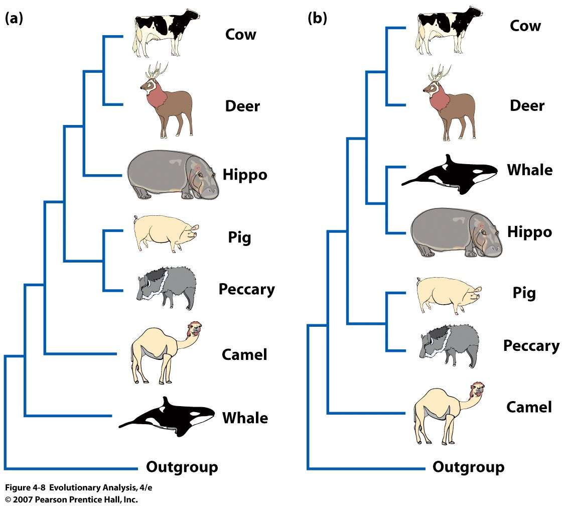
Whales share many features with ungulates.
Which ungulates share the most recent common ancestor with whales?
Artiodactyla
Hypothesis
Outgroup =
Perissodactyla (horses and rhinos;odd toed).
Notes:
Figure 4.8 Phylogenetic hypotheses for whales and other mammals
The tree in (a) shows the Artiodactyla hypothesis: Whales and dolphins are related to the ungulates, possibly as the sister group to the artiodactyls (represented by cows, deer, hippos, pigs, peccaries, and camels). The outgroup to these species is from the ungulate group called Perissodactyla (horses and rhinos). The tree in (b) shows the whale + hippo hypothesis. It is identical to (a) with one exception: The branch leading to whales is moved so that whales are the sister group to the hippos.
Initial evidence from fossils suggested that whales had an astragalus

Slide 24
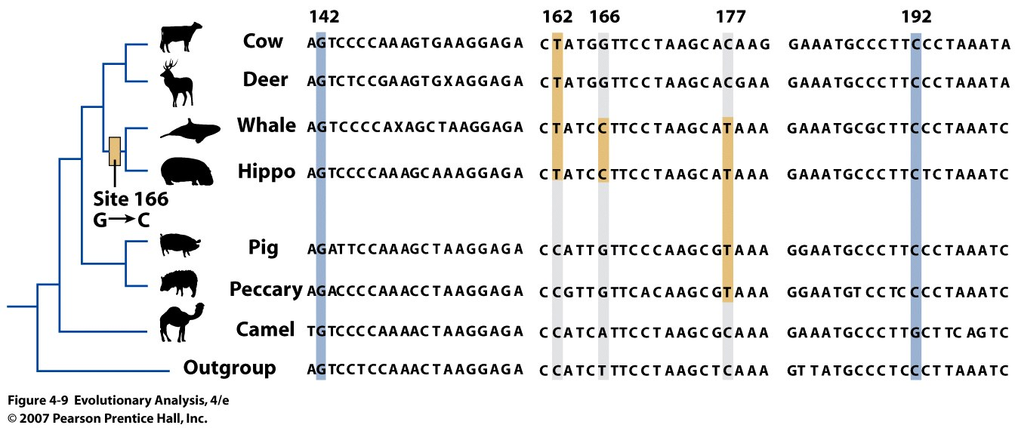
60 nucleotides of aligned sequence from a milk-protein gene
in six artiodactyls
Synapomorphies = shared & derived
Notes:
Evolutionary theory predicts pattern of sequence
Figure 4.9 Sequence data for parsimony analysis
These data are 60 nucleotides of aligned sequence from a milk-protein gene in six artiodactyls, a whale (the dolphin Lagenorhynchus obscurus), and a perissodactyl as an outgroup. An X at a site indicates an ambiguously identified nucleotide. Some of the invariant or uninformative sites are shaded blue; sites that provide synapomorphies are shaded orange. The phylogeny is based on a parsimony analysis of these nucleotide synapomorphies.
Pleisiomorphys are just shared and not derived

Slide 25
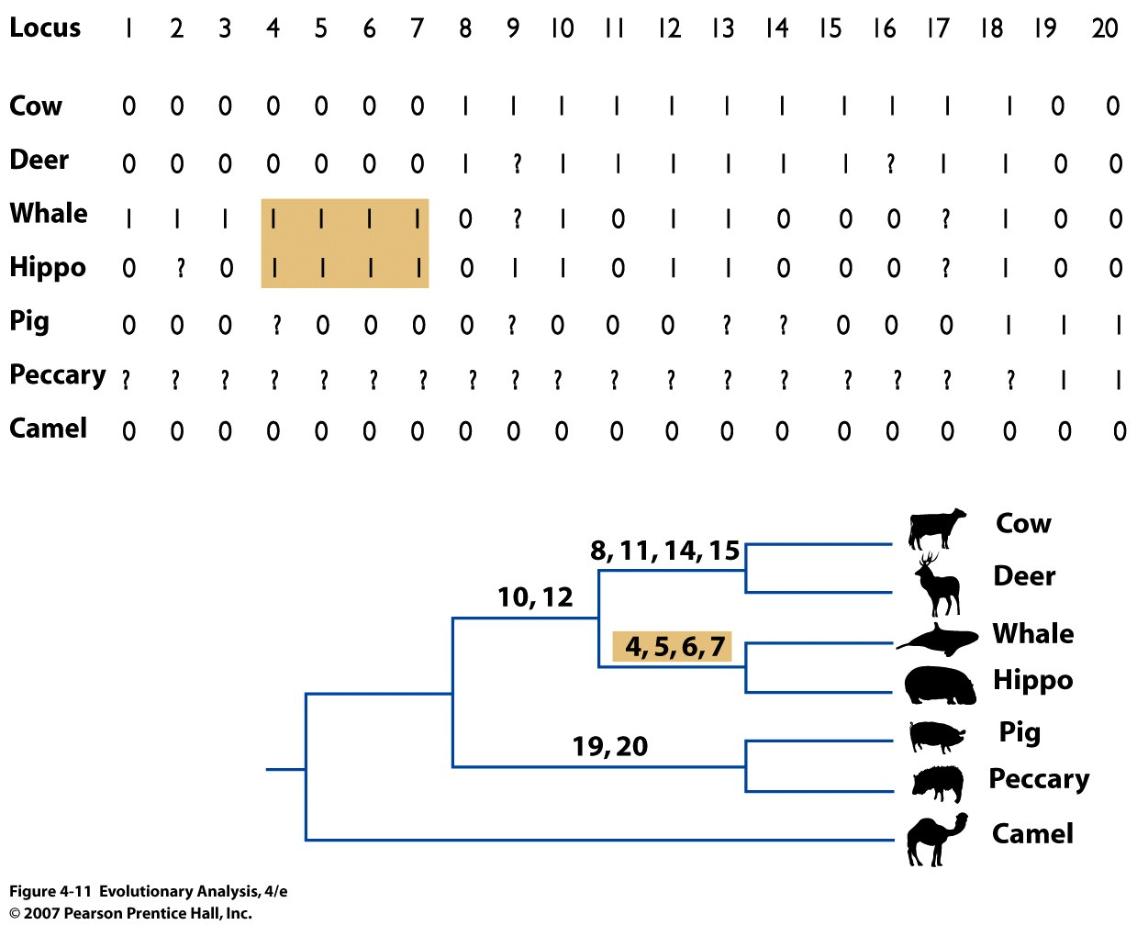
Short or long
Interspersed elements
Notes:
SINES are transposable elements and their transposition is rare (Short or Long INterspersed Elements)
Figure 4.11 Nearly perfect phylogenetic characters?
This table shows the presence (1) or absence (0) of a SINE or LINE at 20 loci in the genomes of six artiodactyls and a whale (Baird's beaked whale, Berardius bairdii). Question marks (?) indicate loci that are questionable in some taxa. Data are from Nikaido et al. (1999). The phylogenetic tree was produced by a parsimony analysis of these 20 characters. The presence of a SINE or LINE at loci 4-7 defines a clade of whales and hippos.
Short or Long Interspered Elements. Parasitic events. Homologous genes

Slide 26
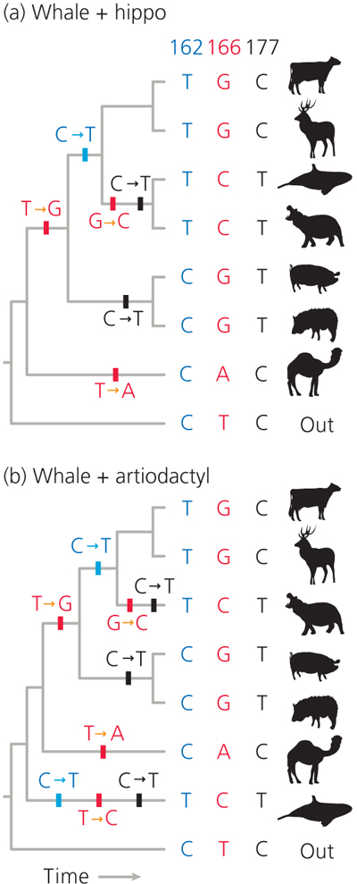
Figure 4-23

Slide 27
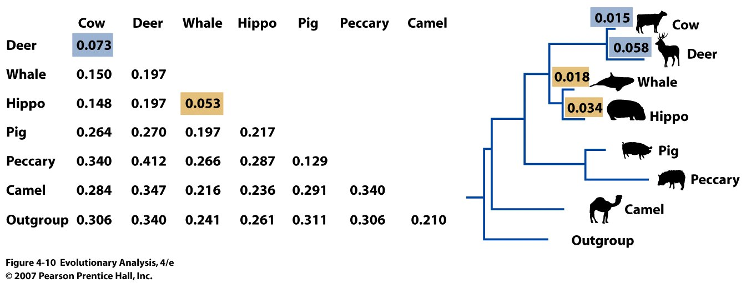
Phenetic approach revisited
Notes:
Figure 4.10 Genetic distances for cluster analysis
Each entry in this table is a genetic distance between a pair of taxa, calculated from the sequence data in Figure 4.9. The phylogeny here was produced by a clustering analysis of these genetic distances. Notice that pairs of taxa with low genetic distances are grouped as sister taxa, such as the cow and deer (blue) or the whale and hippo (orange). The lengths of the branches are proportional to the expected proportion of nucleotide differences between groups, and are shown numerically for several branches.

Slide 28
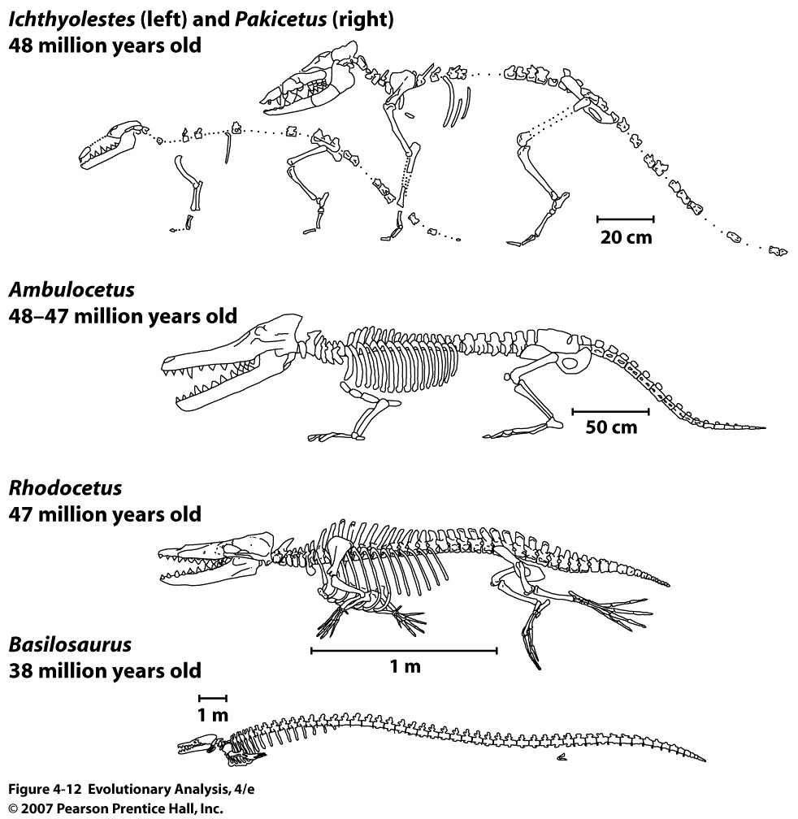
Notes:
Figure 4.12 Early whales moved from terrestrial to aquatic environments
Intermediate fossils have neutron ratio indicative of brackish water, earlier, fresh water.
The fossils pictured here illustrate some of the changes that occurred early in whale evolution, as members of this lineage made the transition from land to water. A comparison of some of these fossils to a modern whale is shown in Figure 2.13.
Some fossil whales have hind limbs and some features of the pulley-shaped astragalus are found in the earliest whales

Slide 29
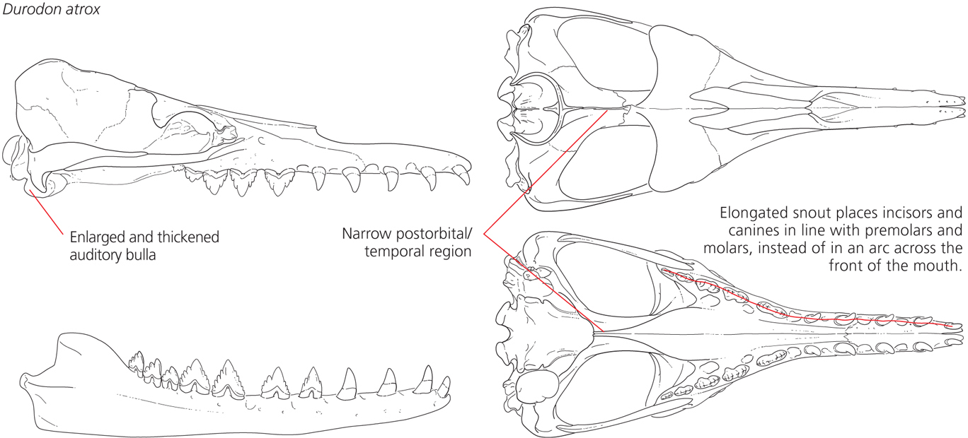
The skull of Durodon atrox (37 mya):
Three shared derived traits that define clade Cetacea

Slide 30
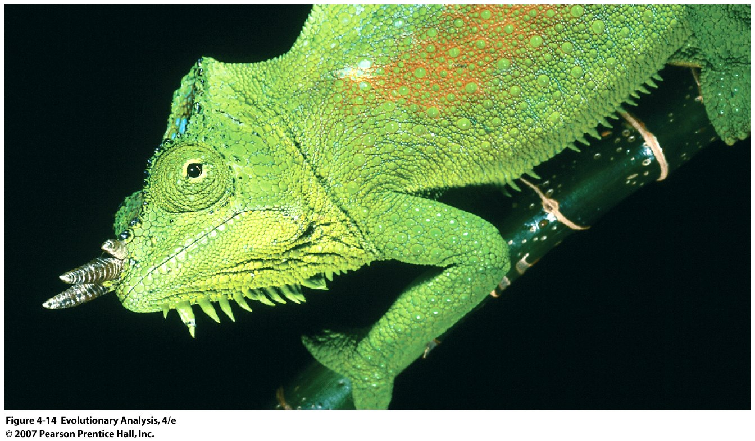
VIII. Using phylogenies to address evolutionary and or ecological
questions
The case of the Chameleon
Notes:
Figure 4.14 Chameleons are a clade of lizards
More than 130 species of chameleons live in Africa, Madagascar, islands in the Indian Ocean, and India.

Slide 31
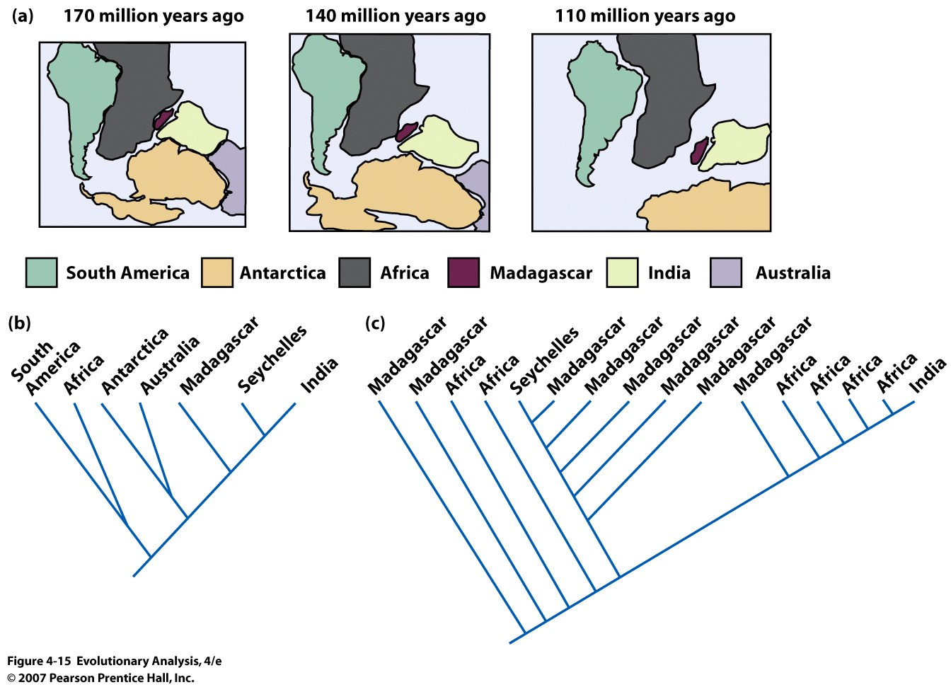
Diversity of chameleons reflect break up of Gondwanaland??
Expected Observed
Notes:
Figure 4.15 Did chameleons speciate when Gondwanaland broke up?
(a) These drawings show the sequence of events that occurred as the supercontinent Gondwanaland broke up. (b) This tree shows the relationships among chameleon groups predicted by the Gondwanaland breakup hypothesis. The Seychelles Islands are not formed of continental plate material (they are volcanic or coral). (c) This tree shows the actual relationships among chameleons.

Slide 32
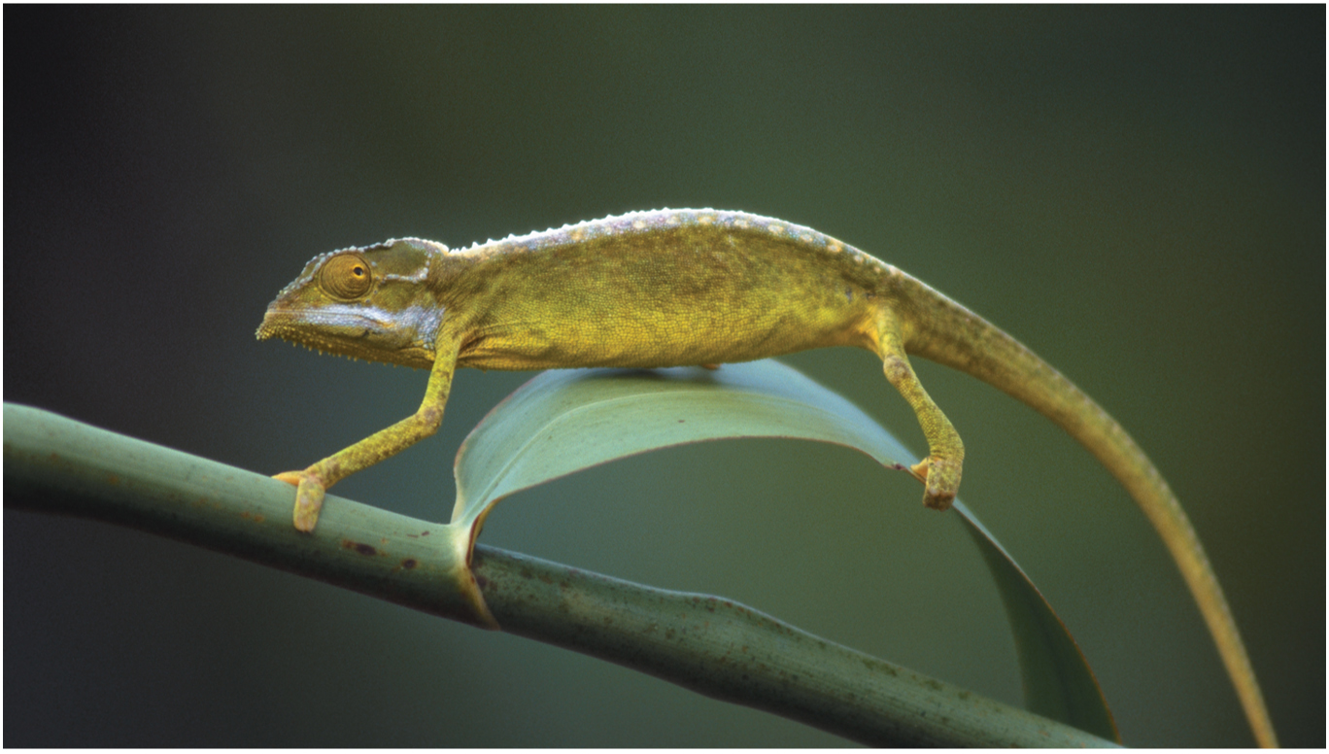
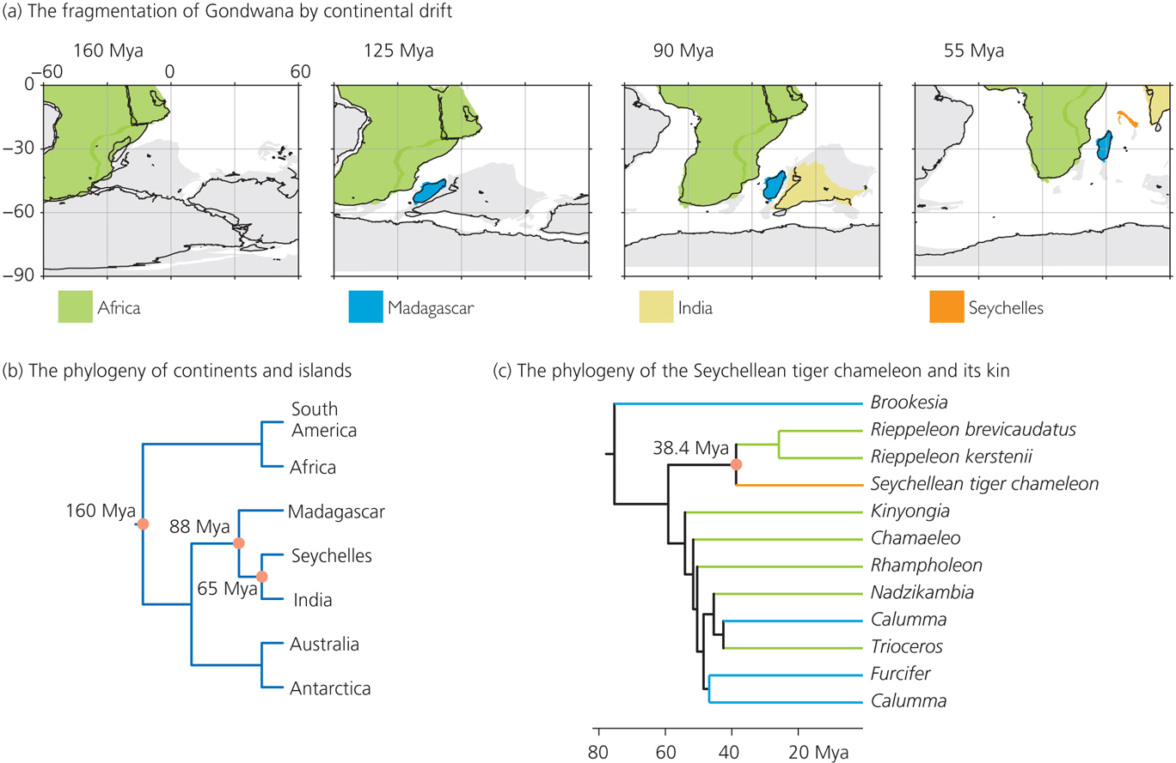
Focus on the Seychellean tiger chameleon

Slide 33
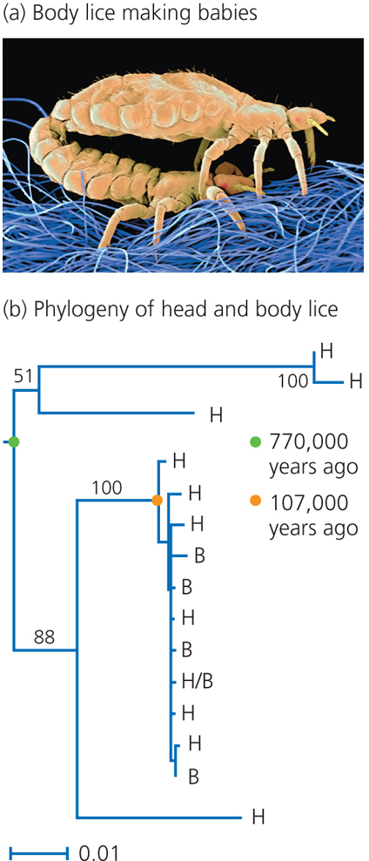
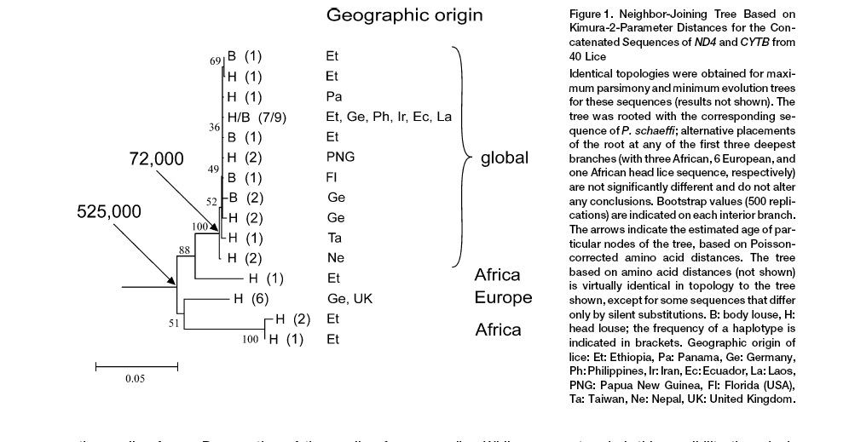
When did humans begin to use clothing???
Kittler et al 2003:
http://www.pbs.org/wgbh/nova/evolution/lice.html
Notes:
Pubic lice origins from gorilla lice, split indicates loss of body hair
Head and body lice, latter live in clothing, split about 100,000 years ago

Slide 34
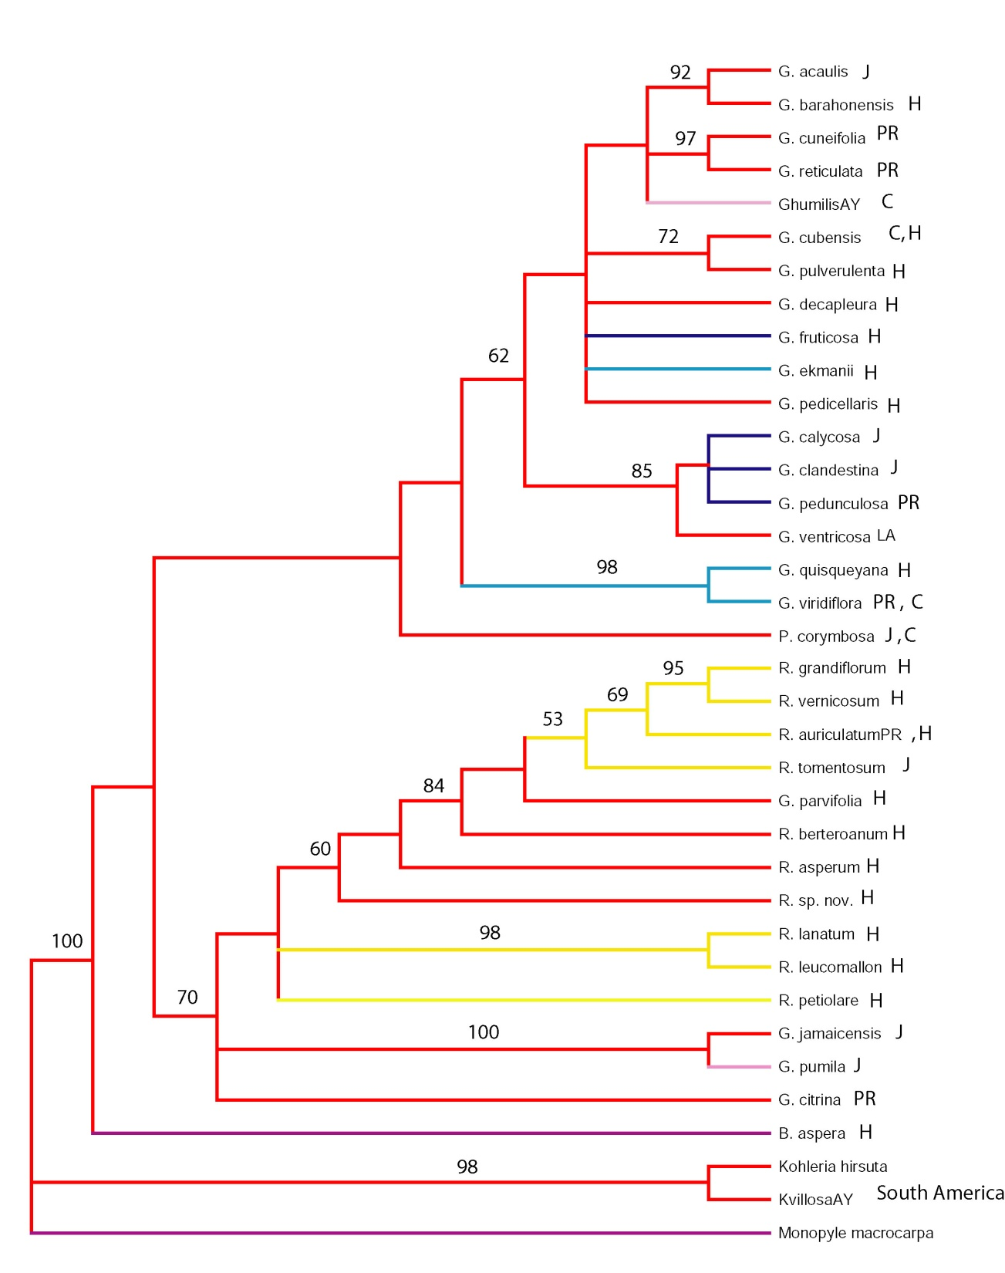
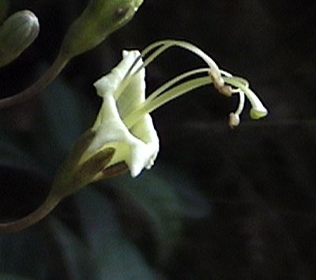
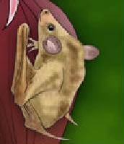
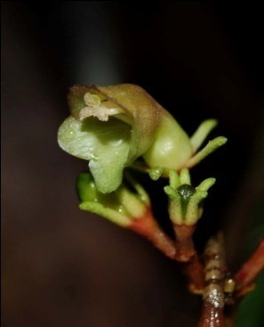



Gesnerieae phylogeny
Combined ITS-Gcy
What ecological conditions lead to evolution
of floral traits??
Hummingbird
Bat
Bat / Moth
Generalist
Bee
ITS + Gcyc
J = Jamaica, H = Hispaniola, Pr= Puerto Rico, C = Cuba

Slide 35

What is the proper model organism for studying Human diseases?
Notes:
Excavates: Super Phylum
Phylogeny allows us to compare diseases to proper model organisms
Some organisms in this order include:
Trichomonas vaginalis, an organism living inside the vagina of humans in phylum/class parasabalia
Dientamoeba fragilis, parasitic ameboid in humans
Histomonas meleagridis, parasite that causes blackhead disease in poultry.
Many excavates lack 'classical' mitochondria - these organisms are often referred to as 'amitochondriate', although most, perhaps all, retain a mitochondrial organelle in greatly modified form. Others have mitochondria with tubular, discoidal, or in some cases, laminar cristae. Most excavates have two, four, or more flagella^{[3]} and many have a conspicuous ventral feeding groove with a characteristic ultrastructure, supported by microtubules.^{[4]} However, various groups that lack these traits may be considered excavates based on genetic evidence (primarily phylogenetic trees of molecular sequences).
The closest that the excavates come to multicellularity are the Acrasidae slime molds. Like other cellular slime molds, they live most of their life as single cells, but will sometimes assemble into a larger cluster.

Slide 36

R. F. Doolittle, IN: Evolution The Molecular Landscape, CSH, 2009

Slide 37
IX. Conclusion
Phylogenetic methods allow us to reconstruct evolutionary
relationships
These relationships can in turn allow us to test evolutionary and
ecological hypotheses
Terms to know: cladistic, phenetic, monophyly, paraphyly,
synapomorphies, homology, homoplasy, convergent evolution,
parallelism, reversal, parsimony, uses

